Slide 1

Rockbuster Stealth LLC Online Video Rental Service Launch
Christina Wiebe February 2024

Slide 2

The Problem
Rockbuster used to have stores around the world. Recently, the company has been facing competition from streaming services and the store count is down to only two. The plan is to use the existing licenses to launch an online video rental service to stay competitive.

Slide 3
Questions to be answered
What is the average rental duration?
Where are the customers?
What differences can be found between geographic regions?
Which movies/genres contributed the most/least to revenue gain?

Slide 4
Rockbuster‘s collection
1000 Movies
17 Genres
Customers in 109 countries
 | Minimum | Average | Maximum
Rental Duration | 3 days | 4.9 days | 7 days
Rental Rate | 0.99 $ | 2.94 $ | 4.99 $
Payment per Customer | 27.93 $ | 102.36 $ | 211.55 $
Movie Length | 46 min | 115 min | 185 min

Slide 5
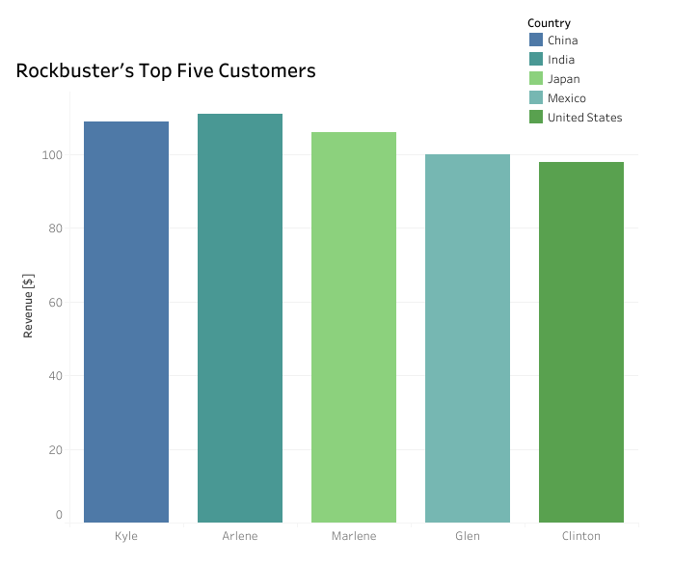
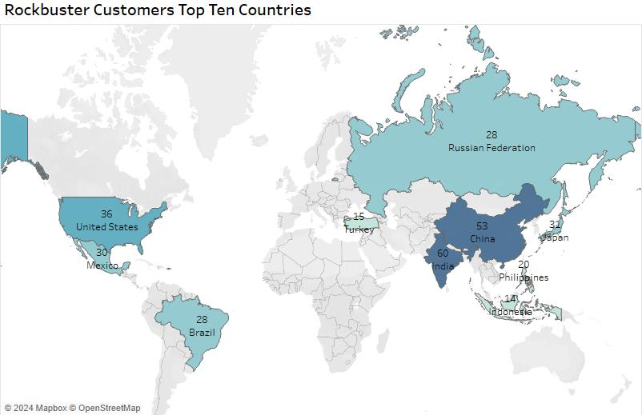
Customer Location

Slide 6
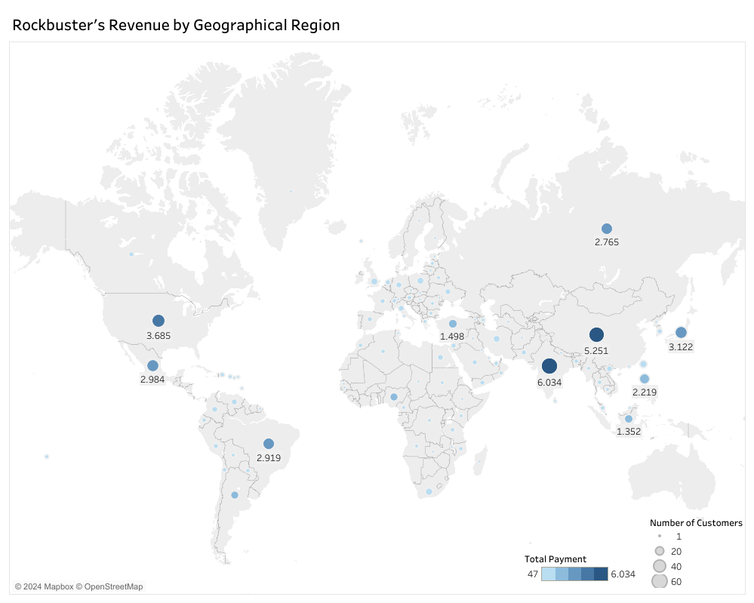
Geographical Regions

Slide 7
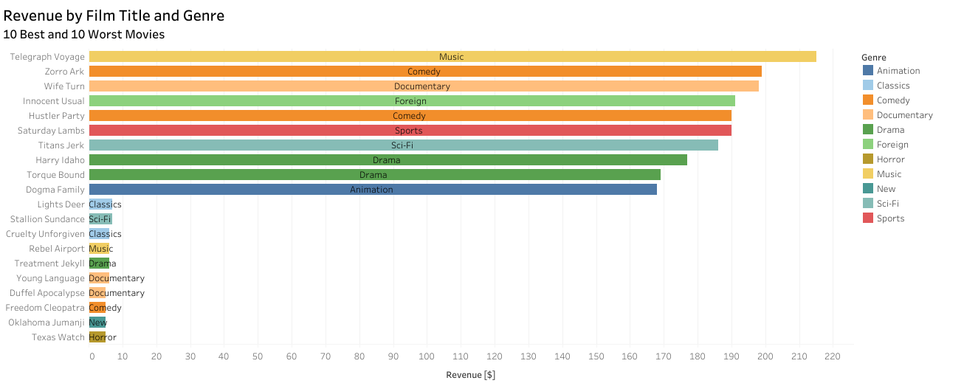
Best and Worst Movies

Slide 8
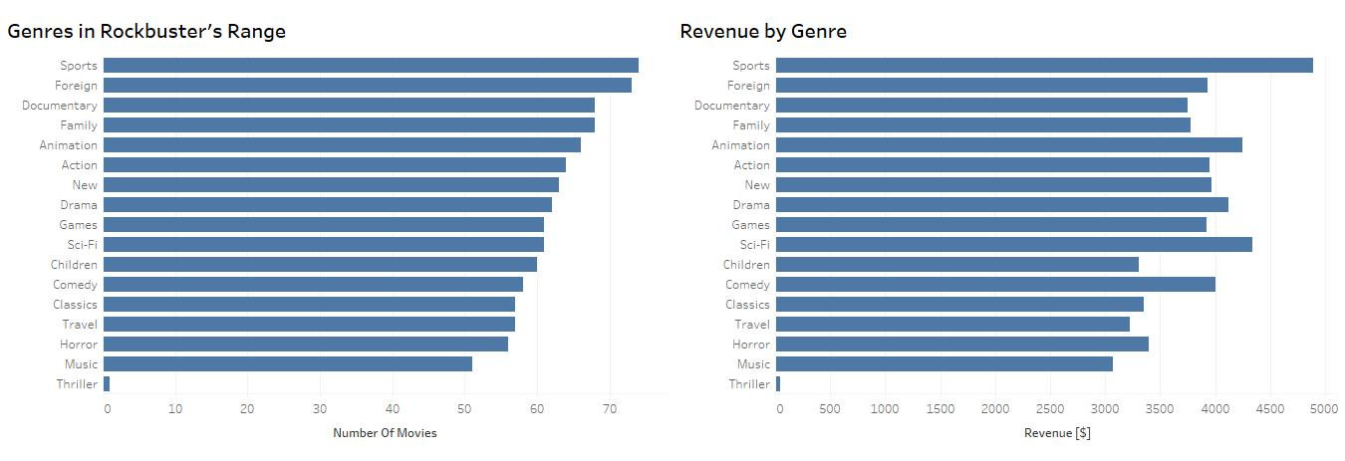
Rockbuster‘s Genres

Slide 9
Recommendations
Marketing
Create a marketing strategy for the top ten countries with the most customers.
India
China
USA
Japan
Mexico
Brazil
Russian Federation
Philippines
Turkey
Indonesia
Genre
Stock up on movies of the genres that bring the most revenue.
Sports
Sci-Fi
Animation
Drama
Comedy
Rewards
Reward customers with a high lifetime value to ensure company loyalty.
Research
There are no Rockbuster customers in Australia. This could be an unexplored opportunity.

Slide 10
Questions?

Slide 11
Thank You for Your Attention
The visualizations from this presentation can be found here:
https://public.tableau.com/app/profile/christina.wiebe/viz/RockbusterPresentation_17091091848390/GenreRevenue#2

